Slide 1
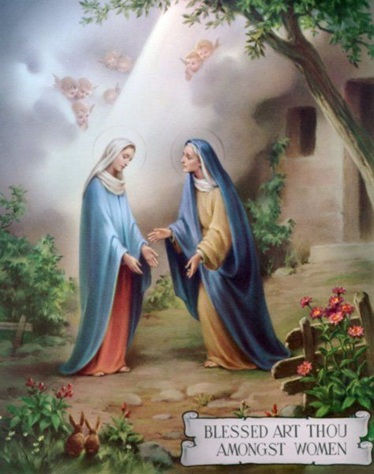
2021年度會長報告 2021Chairperson Report
張洪揚
Jason Cheung

Slide 2
序言 Introduction
本屆聖母訪親堂牧民議會是由2019年1月13日 (星期日) 開始。原定任期為兩年，但碰上疫情關係延長了二年。期間牧民議會會議共開了10次，平均大概每4個月開一次。其中一次以Zoom視像開會。
The present Pastoral Council team took up its responsibilities from the 13th of January, 2019. The term for a council is 2 years however due to the Pandemic council’s term was extended for 2 more years. We had meeting 10 times, once in four months. One of the meeting was conducted through Zoom.

Slide 3
序言 Introduction
本屆聖母訪親堂牧民議會最重要的喜訊是建造新教堂。牧民議會亦為此於2020年間新增了新教堂籌款委員會，積極與教區及教友聯繫和作出講解。
The existing council was happy to hear the good news of the construction of a new church in Tung Chung. We established a Visitation Building Committee to get feedback from the Parishioners about New Church and to give suggestions to Diocesan Building Committee.

Slide 4
序言 Introduction
本屆牧民議會適逢是疫情肆虐最嚴重的時期，很長時間因應政府防疫指引須停止所有活動。但當放寬指引時，堂區及教區為配合政府的防疫指引，需要成立了防疫小組以配合有關要求。雖然本屆牧民議會跟世界一起面對了一個前所未有的疫情及封控措施。但中間還能舉辦一些活動。最後，就為大家總結這些活動。
Pandemic also stopped our regular liturgical activities for a long term in these two years. We followed the Government guidelines for our masses in the School. We had following activities during the last two years in spite of Pandemic.

Slide 5
堂區活動 Parish Activities
暑期期間堂區與學校合作舉行英文班，教導有需要的學童英文；導師是本堂輔祭及青年。2021年8月份向東涌住戶寄出本堂的彌撒時間及課程資訊。
Parish collaborated with the school and taught English to the students freely during the holidays. It was initiated by Pay Love Forward group. Our youth and Alter servers volunteered to teach English. We sent out brochures about our church, liturgical activities through Post Office to the new residents in Tung Chung.

Slide 6
堂區活動 Parish Activities
2021年10月份由本地旅遊公司贊助本堂長者兩次本地遊 (到訪荔枝角公園及展館參觀) 每次約有20多位長者教友參加。本地旅行社由政府資助。
2022年7及8月份由本地旅遊公司贊助本堂長者三次本地遊 (包括:到訪聖堂、公園及展館參觀) 每次約有20多位長者教友參加。本地旅行社由政府資助。
A Local tour company sponsored our elderly for two day outings in October 2021. (Including visiting Lai Chi Kok Park and Exhibition Hall.) About 20 elderly attended every time. The tour company is subsidized by the Government.
A Local tour company sponsored our elderly for three day outings in July and August, 2022. (Including visiting churches, Parks and Exhibition Halls.) About 20 elderly attended every time. The tour company is subsidized by the Government.

Slide 7
堂區活動 Parish Activities
2022年6月黃施博執事- 領授終身執事職及任命他在本堂服務。
Ordination and appointment of Deacon Thomas Wong (19th June, 2022)

Slide 8
禮儀 Liturgy
2021年12月10日為機場主保瞻禮洛雷托聖母紀念日。當天邀請了新任香港教區周守仁主教主禮。
2021年12月16日至23日舉行聖誕九日敬禮彌撒
We celebrated the feast day of the Airport on the 10th of December, 2021. We invited Bishop Stephen, the new bishop of Hong Kong.
Simbang gabi mass (December 16-23, 2021) was celebrated in preparation for Christmas.

Slide 9
禮儀 Liturgy
2021年12月27日邀得湯漢樞機主禮，菲律賓傳教500周年感恩祭2022年5月29日為本堂區主保瞻禮日。當天下午4時在東涌天主教小學禮堂舉行雙語主保瞻禮感恩祭及入門聖事(24位)；並邀請湯漢樞機主禮。
Cardinal John Tong joined us in celebrating the 500th year of Christianity in Philippines on the 27th of December 2021.
Parish feast day was celebrated on the 29th of May, 2022. There were 24 of our brothers and sisters received Baptism. The main celebrant for the Liturgy was Cardinal John Tong

Slide 10
禮儀 Liturgy
2022年6月19日舉行初領聖體(共有11個)
鑑於室內聚會的限制和社交距離措施，四旬期堂區避靜、拜苦路、九日敬禮、朝拜聖體、玫瑰經、彌撒和聖週禮儀都只能透過網上Zoom 舉行。
11 children received their First Holy Communion on the 19th of June, 2022.
We had liturgies like, Chinese Lenten retreat, adoration, mass, rosary, novena and mass through Zoom during the Pandemic.

Slide 11
信仰培育 Faith Formation
成人慕道班和主日學—疫情期間學生會參加Zoom課堂。
每月第二及第四個星期五晚上以ZOOM 舉行聖經分享，由林執事帶領分享主日福音。
RCIA and Sunday school classes were held through Zoom during Pandemic.
Bible sharing of Sunday Gospel was held through Zoom on 2nd and 4th Friday every Month and led by Dn. John Lam.

Slide 12
在疫情期間愛德工作 Pandemic Charity
向有需要的已完約沒有住宿的傭工(菲律賓及印尼)提供食物、防疫用品及防寒衣物。
安排義工向在家隔離的家庭，提供購買糧食、用品服務。
Parish distributed winter clothes, medicine, masks and other items to the helpers who had no accommodation during the winter.
Volunteers helped pandemic affected families and elderly in buying essential things.

Slide 13
在疫情期間愛德工作 Pandemic Charity
本堂與「香港大家庭協會」及家庭婚姻輔導會合作，探訪區內長者送贈愛德包給有需要家庭。
Hong Kong Family Support group and Diocesan marriage and Family Department collaborated with parish in distributing food and medical kits to the elderly.

Slide 14
謝謝 Thanks
報告完畢。End of the Report.

